Slide 1
CAPTCHA based on mouse trails

Slide 2

Background--CAPTCHA
Completely Automated Public Turing Test to Tell Computers and Humans Apart
CAPTCHA based on mouse trails
Notes:
鼠标轨迹识别当前广泛运用于多种人机验证产品中，不仅便于用户的理解记忆，而且极大增加了暴力破解难度。但攻击者可通过黑产工具产生类人轨迹批量操作以绕过检测，并在对抗过程中不断升级其伪造数据以持续绕过同样升级的检测技术。我们期望用机器学习算法来提高人机验证中各种机器行为的检出率，其中包括对抗过程中出现的新的攻击手段的检测。
Mouse trajectory recognition is widely used in a variety of human-machine verification products. It not only facilitates the user's understanding of memory, but also greatly increases the difficulty of violent hacking. However, the attacker can generate human-like trajectory through black tools to bypass detection and continuously upgrade its counterfeit. We expect to use machine learning algorithms to improve the detection rate of various machine behaviors in human machine verification, including the detection of new attack methods during confrontation.

Slide 3
Data set
The data comes from the mouse trajectory collected by a CAPTCHA product and is desensitized.
There are 100,000 data for training and testing.
Fields | Type | Description
a1 | bigint | ID
a2 | string | Mouse trails (x, y, t)
a3 | string | Target (x, y)
label | string | 1-normal, 0-machine

Slide 4
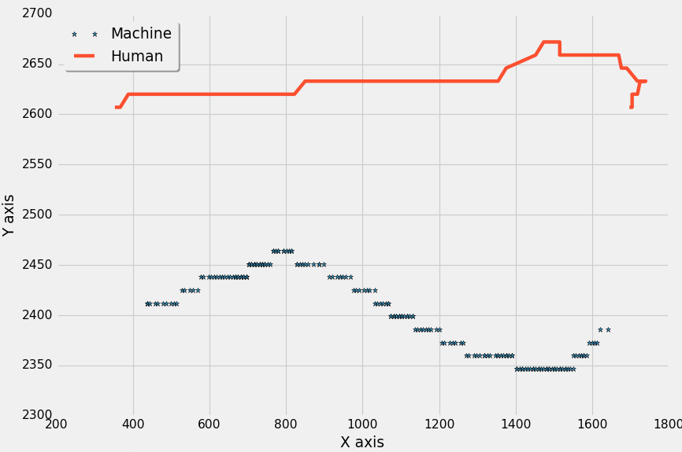
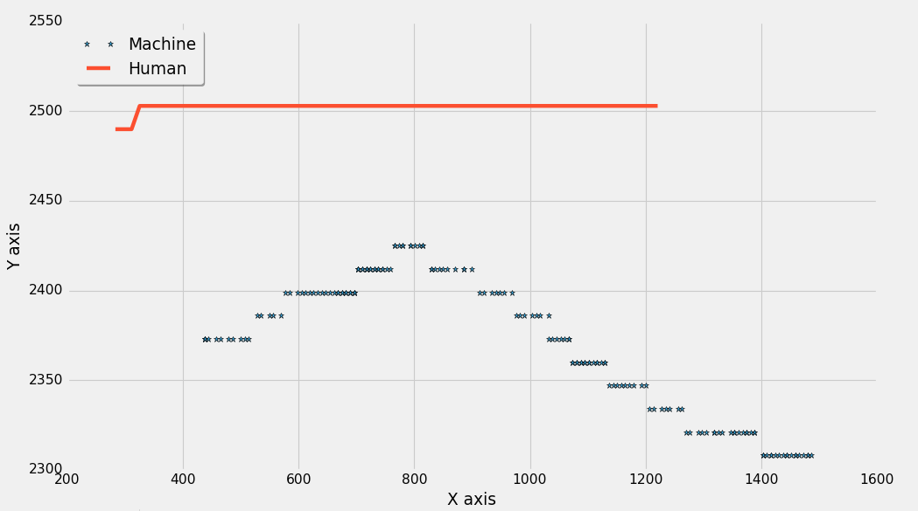
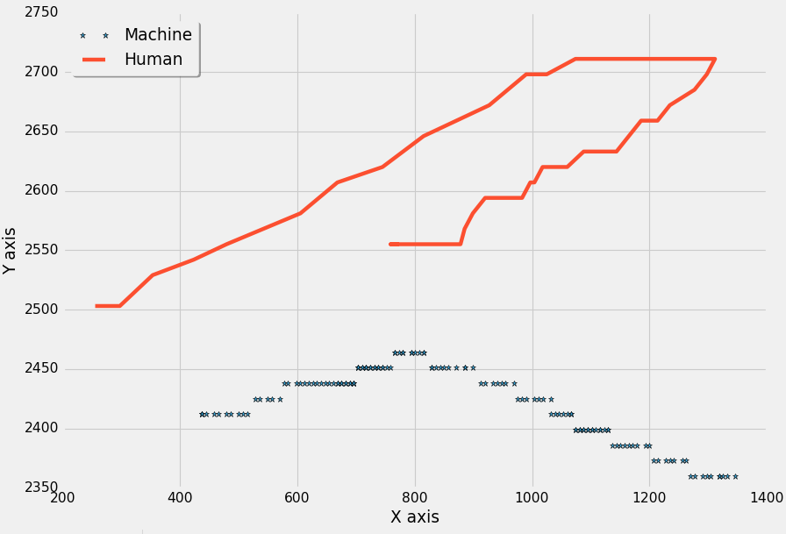
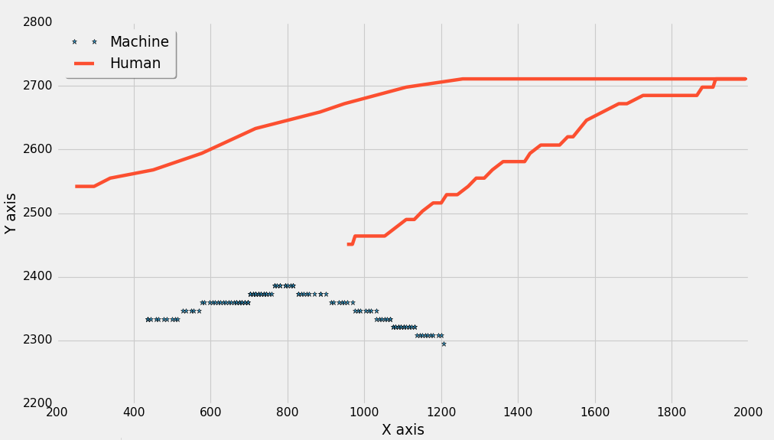
Ideas
How machine and human move across the screen
Notes:
Here are some ideas.
Firstly the pictures shows how human and machine moves in the screen.
X and Y is the location of the mouse when sampling.
As you can see, human moves more randomly while machine always try to follow certain pattern.

Slide 5
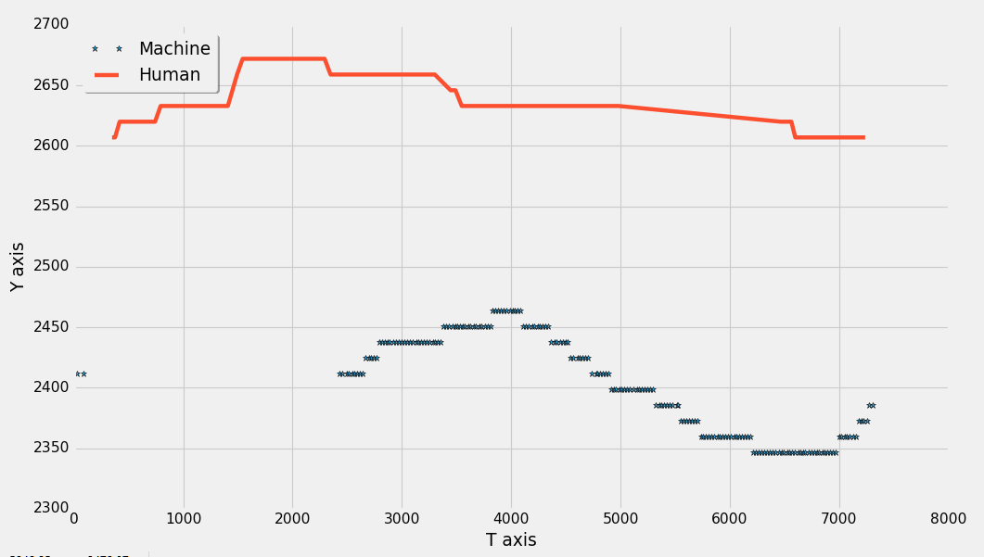
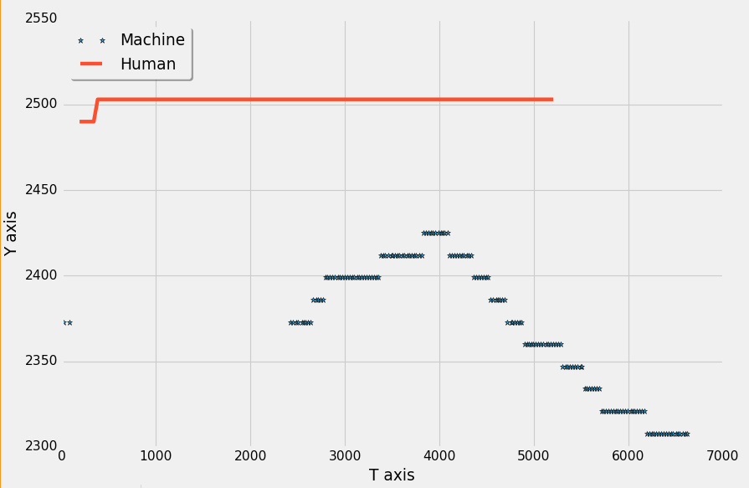
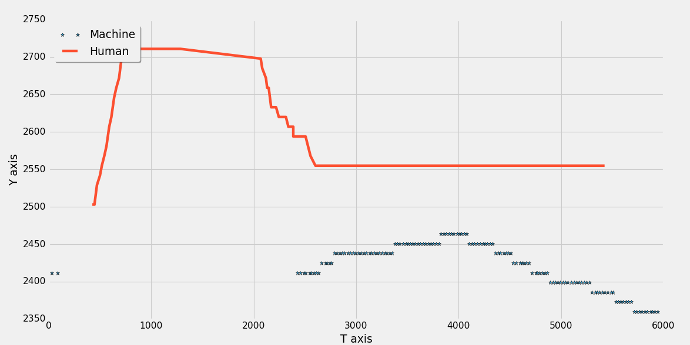
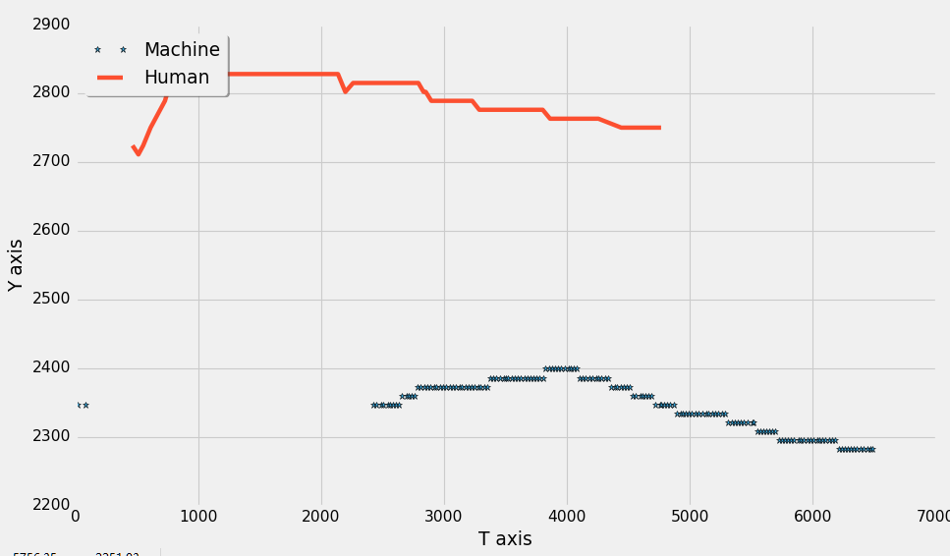
Ideas
How machine and human behave in the y-axis over time
Notes:
Another phenomenon we observed is that :
Human also moves more randomly over time while machine sample points is more smooth over time.

Slide 6
Ideas
Feather engineering
velocity
derivative of velocity
Statistical characteristics of velocity
Shape of moving trajectory
… …
Notes:
Feather engineering is always the most important thing we care about in traditional ML process.
In summary ,there are feathers like these.
Also a good opportunity to practice your imagination and skills.

Slide 7
Machine Learning
Binary Classification
Bayes
Logistic Regression
Neural Network
Ensemble learning
AdaBoost
XgBoost
Bagging
Notes:
You may use binary classification classifiers to solve the problem.
And if possible , ensemble learning methods, such as a popular tool Xgboost is helpful!
After finishing it, you may find it very easy to participate many competitions like Tianchi and Kaggle.
So do not wait and join us!

